Slide 1
Project – Kanban board
Prepared by,
Baskaran A,
Rama Lakshman A,
Mayuri

Slide 2
Problem statements
Design a single-page application for the Kanban Board.
Adhere to SRP and DRY principles.
User Interface should be pleasing.
Board can be accessed only for valid users.
Team members can also get the credentials for accessing the board.
Save the board details in the Databases.
After completing each task send the notification and save it in the database.
Apply the WIP(Work In Progress) limit to each member for the In-Progress stage.

Slide 3
Introduction to project
Kanban is a workflow management method that allows project managers to visualize their team’s work on easy-to-use boards that facilitate planning, scheduling, and tracking work.
Kanban's visual nature makes it easy for team members to see the flow of work at a glance.
Work items in Kanban are represented by cards on the board and Each card contains essential information about the task, making it easy to understand and prioritize.
Kanban allows teams to define and adapt their workflows based on the unique needs of their projects.

Slide 4
Tools & Technologies
Angular framework – used to create a single-page website for Kanban-board.
JWT – used for authorization of users.
Mysql database- used to store the login credentials of the users in table format.
Mongo database- used to store the board information and notifications in document format.
Spring boot framework – used to create the web application for the Kanban board.
Microservices design patterns
API Gateway pattern - acts as the single entry point to our application.
Service Discovery pattern – used to route requests for the client to the available service instance of the microservice.

Slide 5
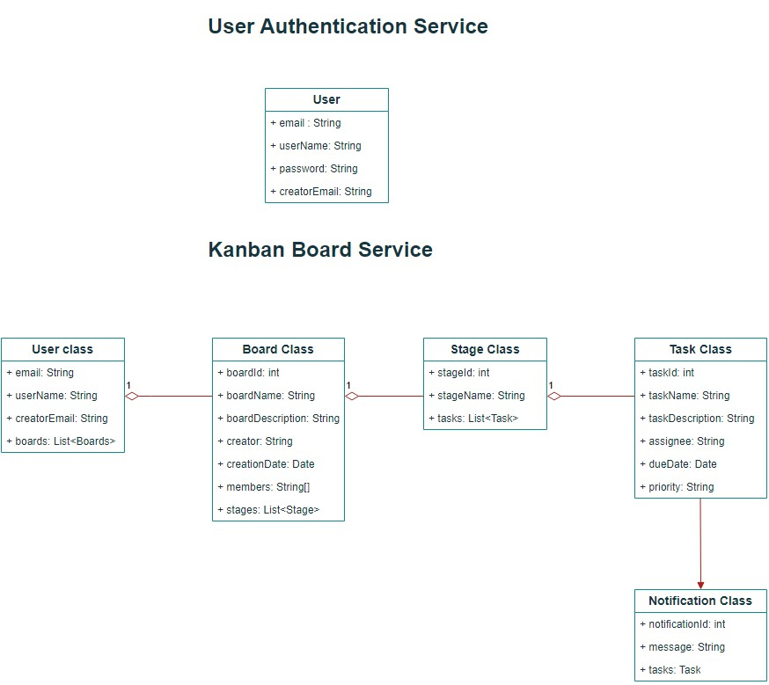
Class Diagram

Slide 6
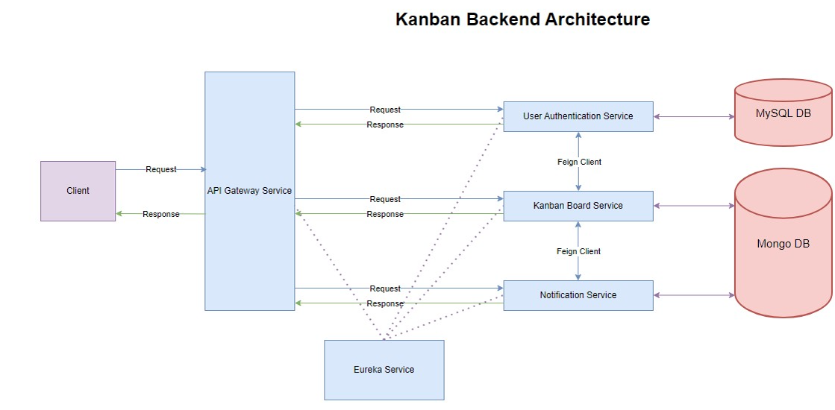
Architecture Diagram

Slide 7
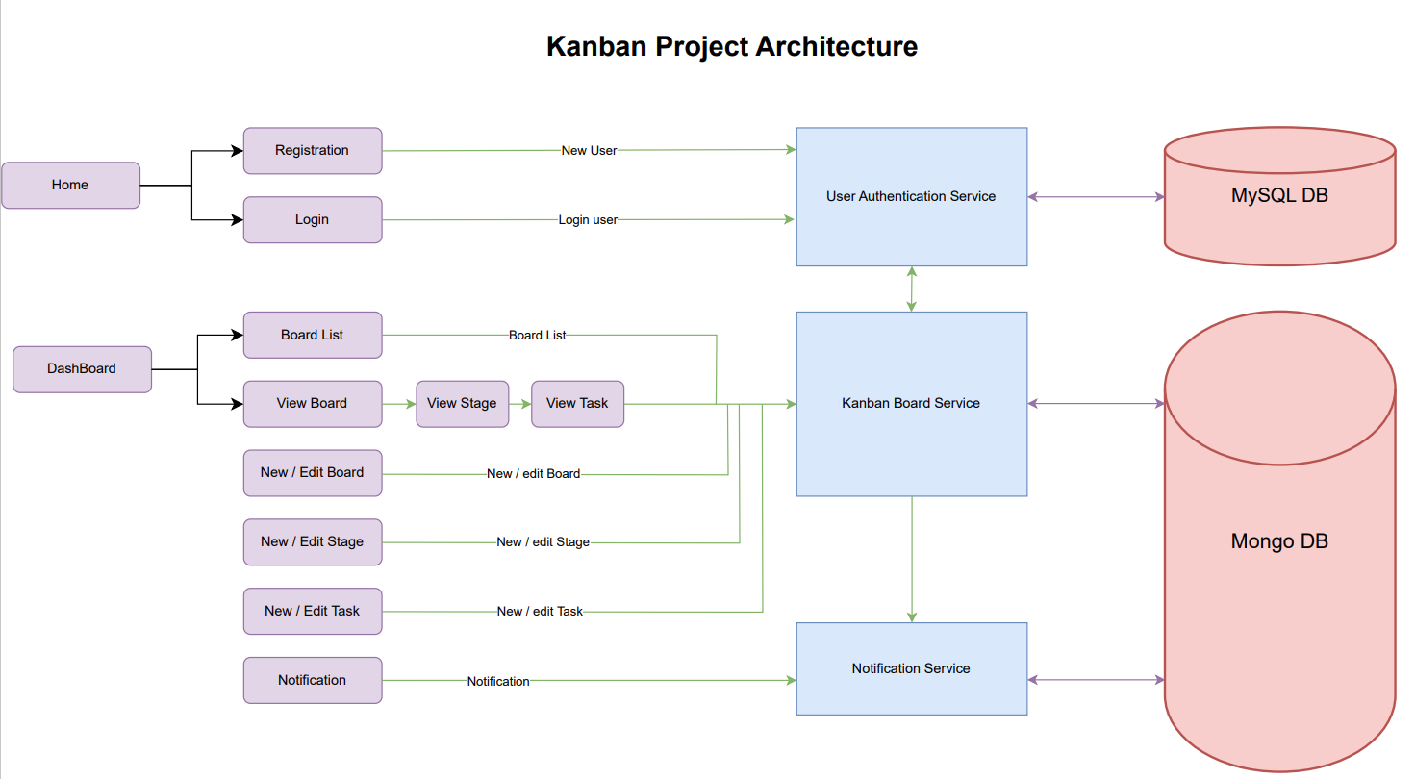
Architecture Diagram

Slide 8
Working of Kanban Board
Only authorized users can access the Kanban dashboard.
The user can add the team members to the board and members will get permission to access the board through login.
Creation of the new board will have 4 stages as default stages and they are To be done, In progress, backlog, and completed.
New tasks can be added only to the To be done stage.
Each task can be assigned to only one member from the team members list.
Tasks can be moved to different stages.
Each member can have a maximum of 2 tasks in In progress stage.
When the task is completed, the user can see that message in the notification tab.

Slide 9
Demonstration

Slide 10
Future Enhancement
Implementation of drag and drop feature for tasks.
Sending emails to the users when they registered and tasks completed.
Implement a sideNav feature for the boardList view.
Implement the edit profile option.

Slide 11
Conclusion
Single page application for Kanban Board is created using the angular framework.
JWT is used to authorize users to the dashboard.
User login information saved in Mysql database.
Board information saved in Mongo database.
Q & A

Slide 12
Bibliography
For Spring boot application: https://spring.io/
For Angular framework: https://angular.io/
For Angular Materials: https://material.angular.io/
For CSS: https://getbootstrap.com/
For CSS: https://fonts.google.com/icons
Kanban board ref: https://kanbantool.com/kanban-board
Kanban board ref: https://trello.com/

Slide 13
Thank You

